Slide 1

Group 2
Manuel G, Paul C, Nick V
Multiplayer Blackjack
Design

Slide 2
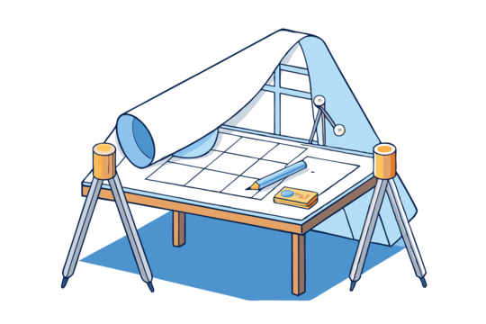
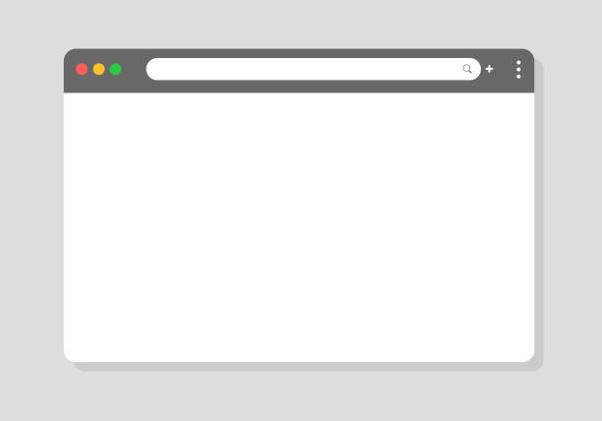


Introduction
Approaching Design
Concepts Vs Execution
Addressing The Problem
Going from plan to preparation
Understanding user flow and intended, common sequences
How are we bridging the gap to deliver

Slide 3
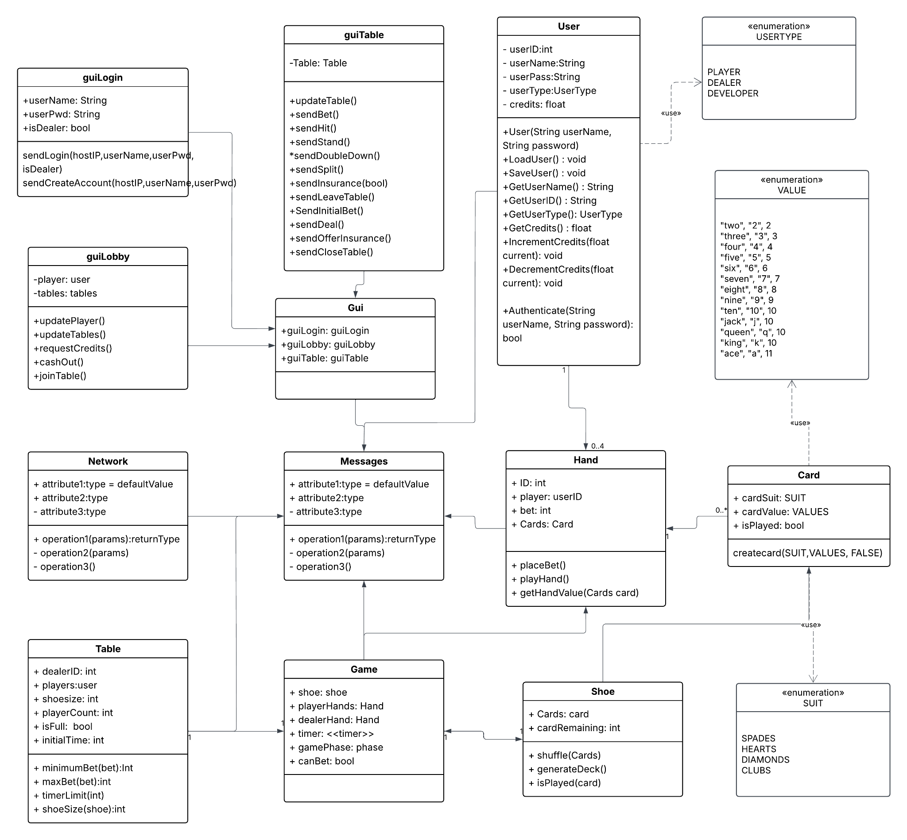
Architectural Design
Networking: Facilitate communications between the server and multiple clients. This will require multi-threading and synchronous communication to allow each client to view the current in-game status.
Messaging: The specific communications between the server and client. Managing the sequence of events Between the client and server that allow for logging in and out, account management, game selection, and in-game activities.
Client: Manages the interfaces the players and dealers interact with. Displaying vital information to all users to help them navigate through the processes involved with-in the application. Each interface interacts with different elements of the messaging system to display information from the server or send user requests to the server.

Slide 4
Architectural Design Cont.
Server: Handles most of the workload for the blackjack application to function.
Facilitating multiple clients through the network and messaging components.
Storing and updating user data as information changes during gameplay.
Managing each table within the application, providing real time details regarding settings and availability.
Providing in-game management functionality for each player. Allowing them to bet, hit, stand, or request other elements of gameplay.
Providing in-game management functionality for each dealer. Allowing them start each round by requesting initial bets, offer insurance, deal cards as requested by players, etc.

Slide 5

System Interface
The program itself is divided into 3 primary interfaces: login, lobby, and table
Each interface represents a distinct stage of interaction
Consistent structure and navigation across all views
GUI composed of modular, dynamic elements
Interface updates based on user roles, application state, and game phase
Only valid actions are interactable at any time

Slide 6
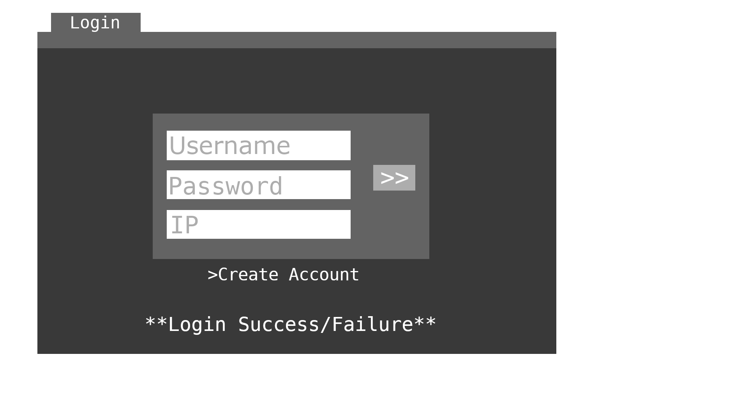
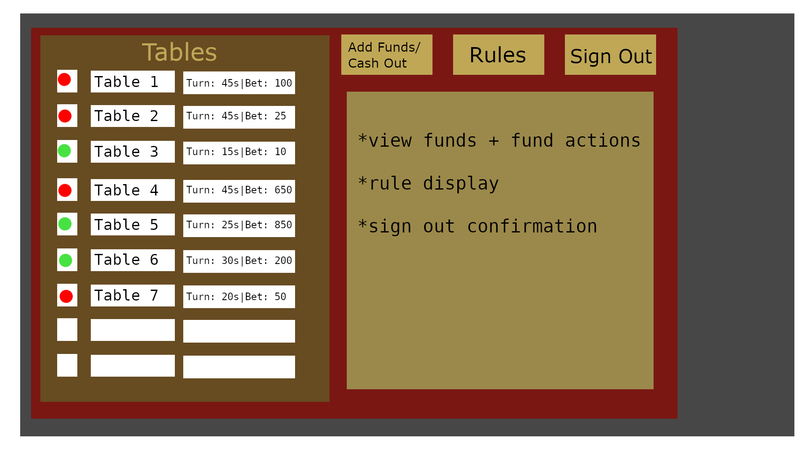
Interface Cont.

Slide 7
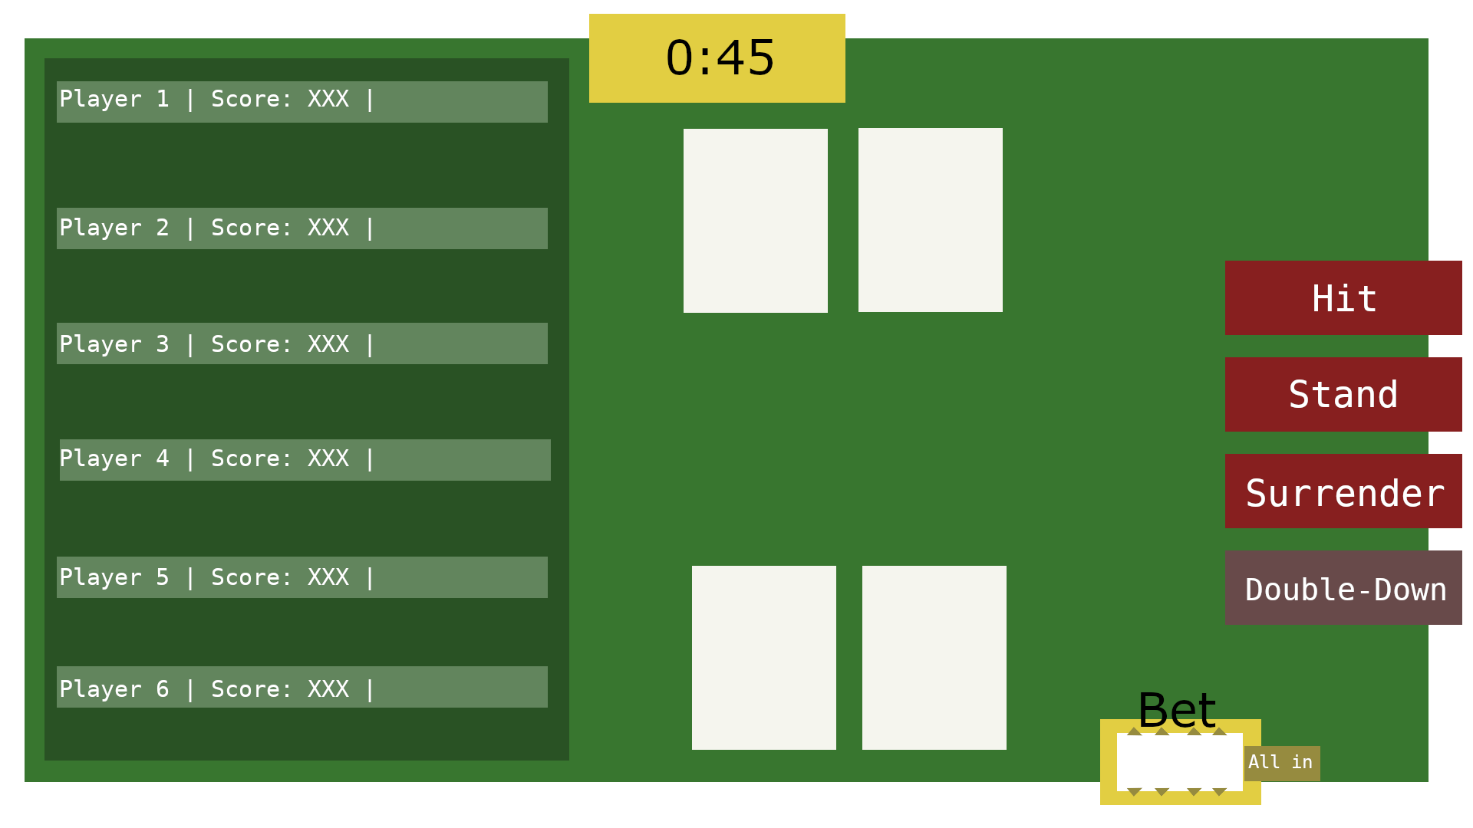
Interface Cont.

Slide 8
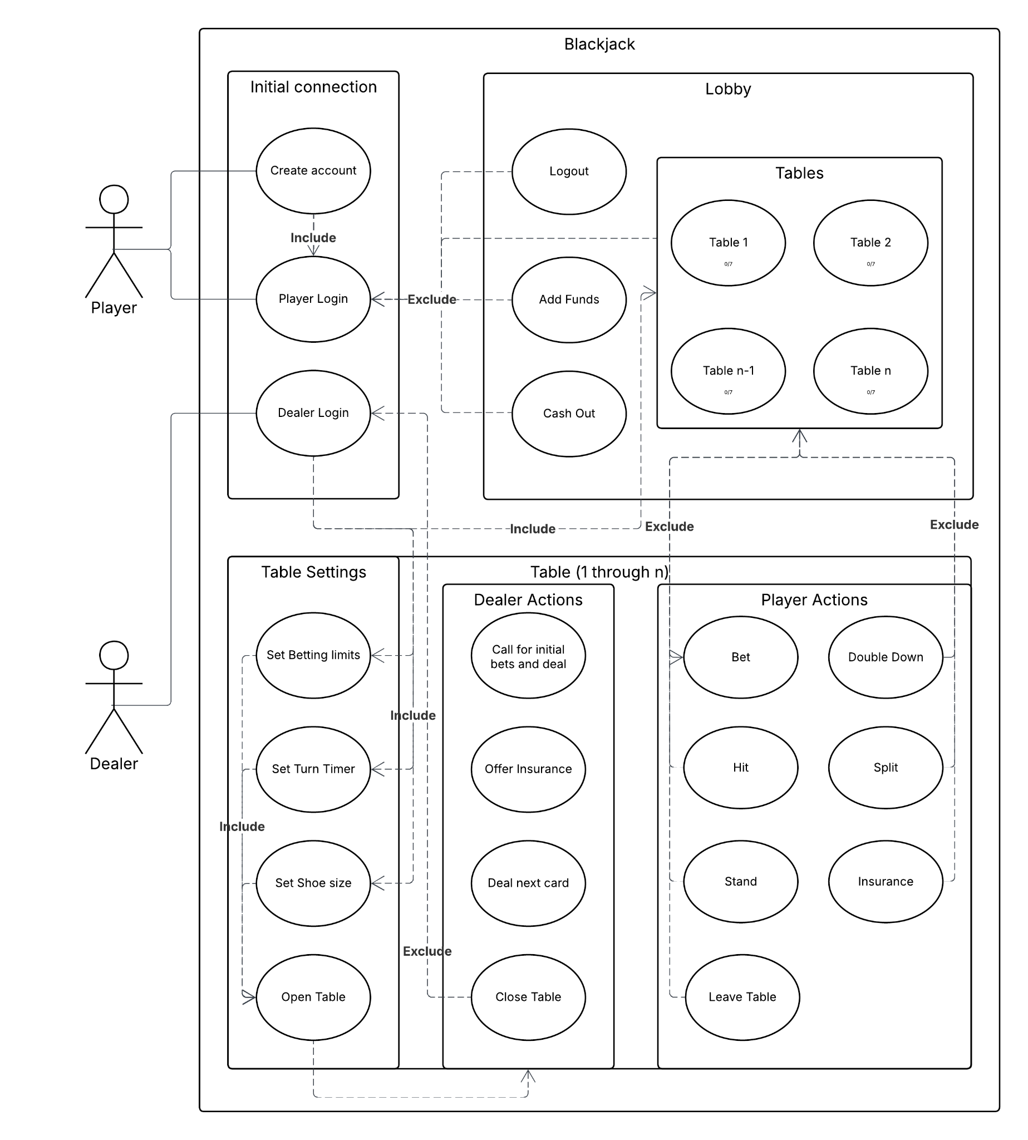
Use-Case
Player: Has fun and plays the game.
Can create account within client, and login.
In the lobby, player can add or removed funds, or select a table to join.
At the table, player can place bets, and perform actions such as hitting or standing
Dealer: Initializes game table and facilitates game flow
Account creation can be done in client, but promotion to dealer must be made server side.
After login, dealer is prompted to create table.
Responsible for starting each round of play and dealing cards as needed until table is closed.

Slide 9
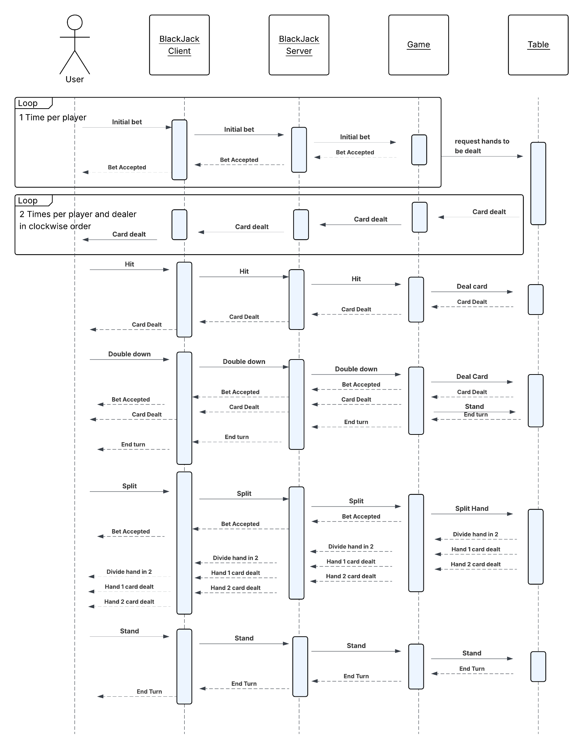
Player In-Game Sequence
Within the design document, we have addressed multiple sequences from logging, lobby interactions, and in game functionality.
Player in-game sequence is displayed as an example , and the most often used sequence.
The most complicated steps occur at the start of each round as all players must make an initial bet before the game can start. Once initial bets have been placed, the cards must be dealt in turn to each player and the dealer.
Once initial opening steps is complete, the sequence is more straightforward. Players still take turns, but once it is their turn they can take as many steps as needed to complete their turn.

Slide 10
Closing
Foundations from initial phase, requirements, and now design
Dissection of architecture to address the problem, and how our product solves it
What’s next

